Slide 1
The Emerging “Research Informationist” Role
Lisa Federer, MLIS, MA, AHIP
Research Informationist
UCLA Louise M. Darling Biomedical Library

Slide 2
The Research Informationist
What is an informationist?
My path to becoming a research informationist
The role of the research informationist in practice
Core competencies for informationists
Considerations for planning a new informationist program
Practical tools and resources for informationists

Slide 3
What is an Informationist?
Notes:
History of term – coined by Davidoff and Florance in 2000 issue of Annals of Internal Medicine
Lack of general consensus, but a few qualities usually applied to the term

Slide 4
What is an Informationist?
Notes:
History of term – coined by Davidoff and Florance in 2000 issue of Annals of Internal Medicine
Lack of general consensus, but a few qualities usually applied to the term

Slide 5
What is an Informationist?
Image via HLWIKI Canada
Embedded in clinical or research setting
Notes:
Embedded in clinical setting – this is the traditional role, but now moving into research setting as well

Slide 6
What is an Informationist?
Image via Texas Science News
Subject matter knowledge

Slide 7
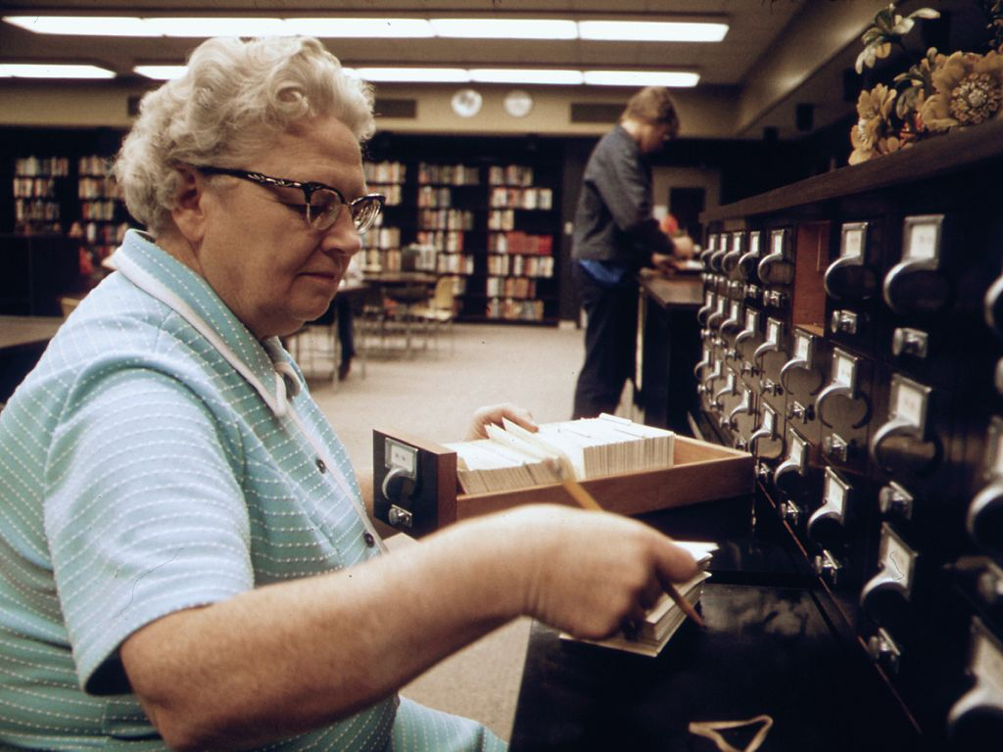
What is an Informationist?
Image via David Rees, Wikimedia Commons
“Traditional” library skills and knowledge

Slide 8
Becoming an Informationist

Slide 9
Becoming an Informationist
science
education

Slide 10
Becoming an Informationist
science
education
teaching
experience

Slide 11
Becoming an Informationist
science
education
teaching
experience
data
training

Slide 12
Becoming an Informationist
science
education
teaching
experience
data
training
campus
need

Slide 13
Becoming an Informationist
science
education
teaching
experience
data
training
campus
need
support
from
admin.

Slide 14
Roles for Informationists
Notes:
Connect research team with needed resources/people

Slide 15
Roles for Informationists
Image via My Welcome to the City
Connector
Notes:
Connect research team with needed resources/people

Slide 16
Roles for Informationists
Image via Global Economic Intersection
Information organizer
Notes:
Help the research team with organizing their data – this is a major need.

Slide 17
Roles for Informationists
Image via Zazzle
Expert searcher
Notes:
Connect research team with needed resources/people

Slide 18
Roles for Informationists
Image via Scott Ross
Research team member
Notes:
Overall, my goal is to be viewed as a member of the research team capable of offering worthwhile advice and input

Slide 19
Core Competencies

Slide 20
Core Competencies
Plan
Publish
Collect
Research Data
Life Cycle
Share
Manage
Familiarity with data practices

Slide 21
Core Competencies
Image via Paperweight Publications
Familiarity with scholarly communication and licensing issues

Slide 22
Core Competencies
Knowledge of grant funders and their policies

Slide 23
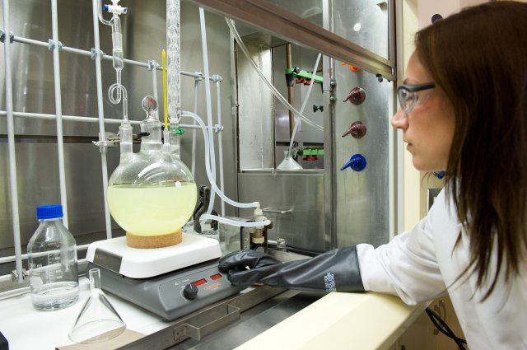
Core Competencies
Image via US Military
Awareness of research practices in the field

Slide 24
Core Competencies
Image via Georgia Tech Research News
Ability to understand subject matter knowledge
Notes:
This is distinct from formal scientific training, which I do not argue is necessary

Slide 25
Core Competencies
Image via http://www.thetoddanderinfavoritefive.com/
Innovative and willing to take risks
Notes:
This is distinct from formal scientific training, which I do not argue is necessary

Slide 26
Considerations

Slide 27
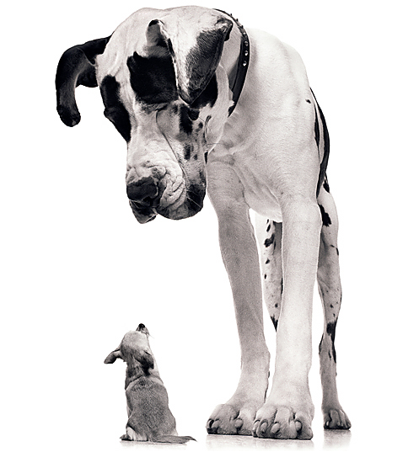
Considerations
Image via HD Wallpapers
Start with smaller research groups

Slide 28
Considerations
Image via University of New Mexico
Plan for sustainability

Slide 29
Considerations
Image via Recruitment Dad
Outreach is key

Slide 30
Considerations
Image via Cat Morgan
Allow (and encourage!) innovation and risk-taking

Slide 31
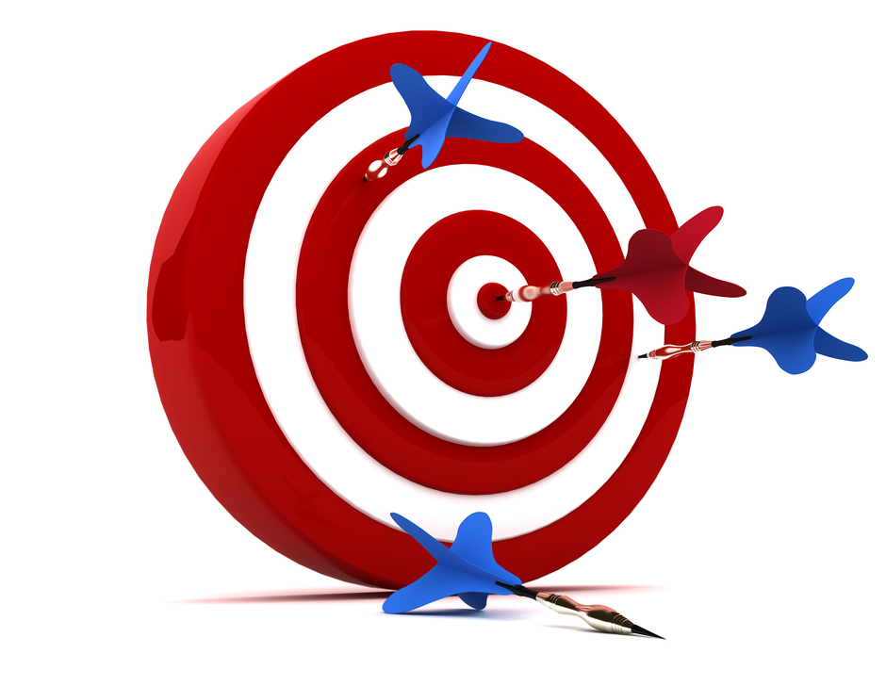
Tools and Resources
Image via http://www.mmagazine.com
Identify researchers for targeted outreach

Slide 32
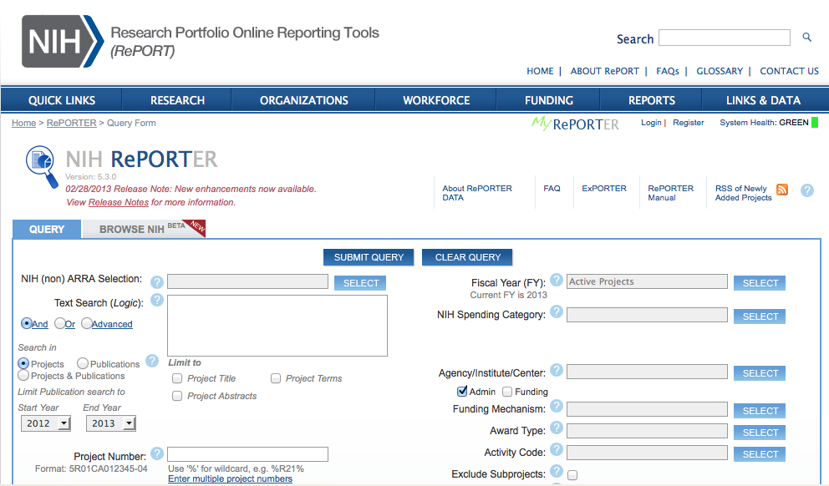
NIH RePORTER http://projectreporter.nih.gov

Slide 33
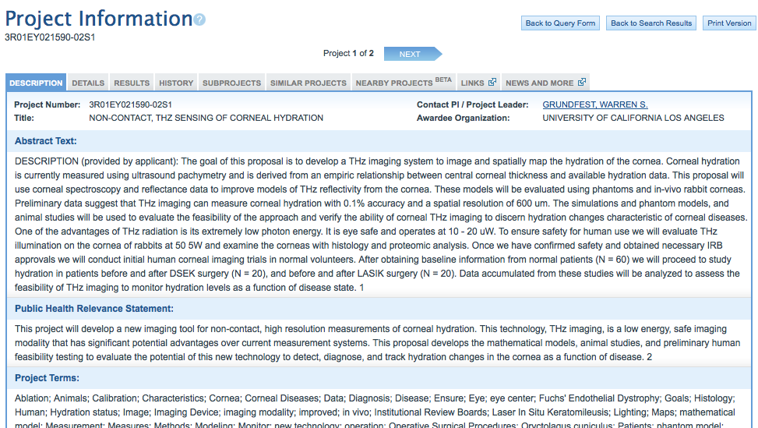
NIH RePORTER http://projectreporter.nih.gov

Slide 34
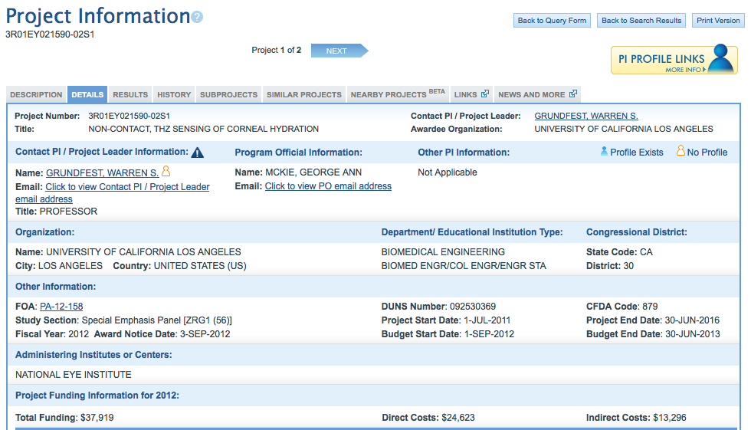
NIH RePORTER http://projectreporter.nih.gov

Slide 35
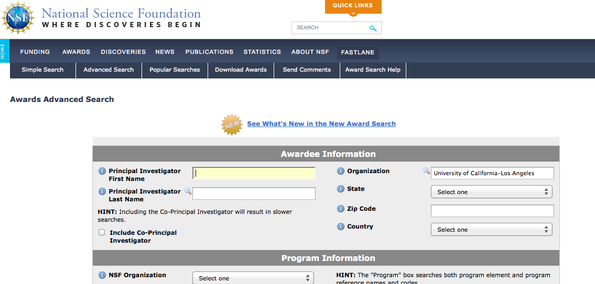
NSF Awards Search http://www.nsf.gov/awardsearch

Slide 36
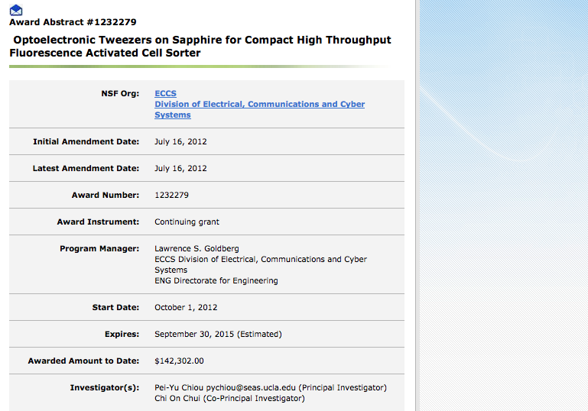
NSF Awards Search http://www.nsf.gov/awardsearch

Slide 37
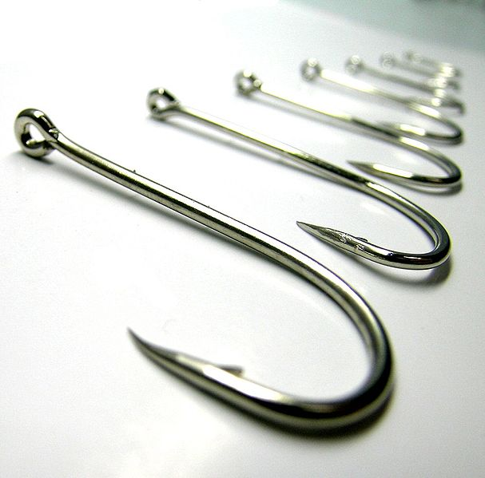
Tools and Resources
Image via Wikimedia commons: http://9686.openphoto.net/
When you approach researchers, you need a “hook”

Slide 38
NIH Public Access Compliance Monitor
Identify researchers not currently in compliance with policy

Slide 39
DMPTool http://dmp.cdlib.org
Interactive tool for researchers planning for data management

Slide 40
DataUp http://dataup.cdlib.org
Free Excel add-in to assist with research data management

Slide 41
Questions?
Lisa Federer, MLIS, MA, AHIP
UCLA Louise M. Darling Biomedical Library
lmfederer@library.ucla.edu
http://www.lisafederer.net
@lisafederer

